Slide 2
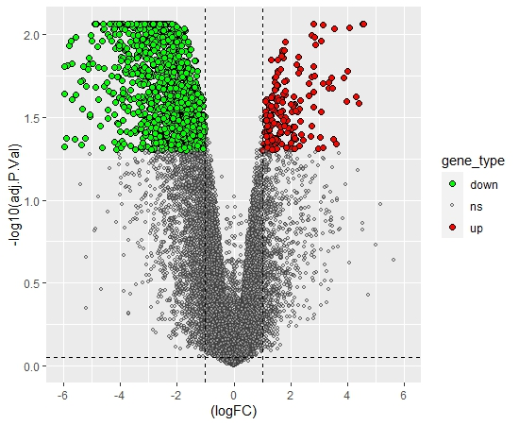
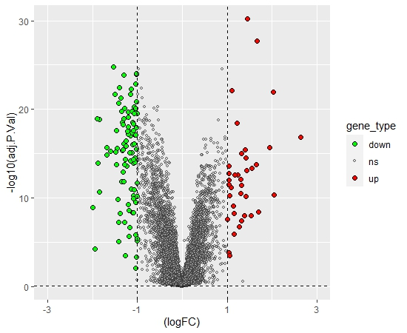
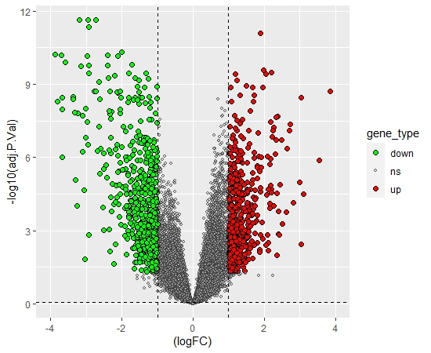
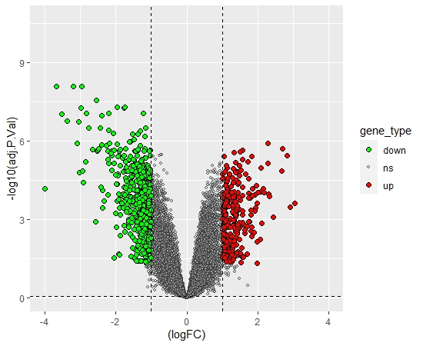
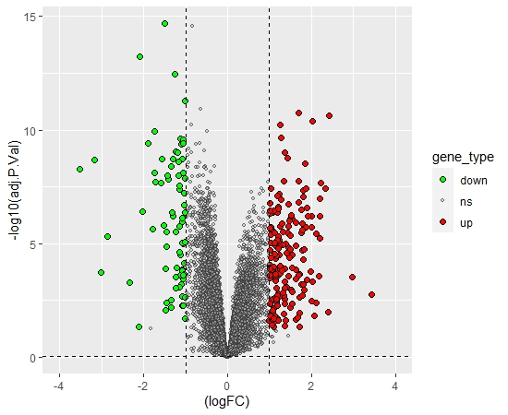
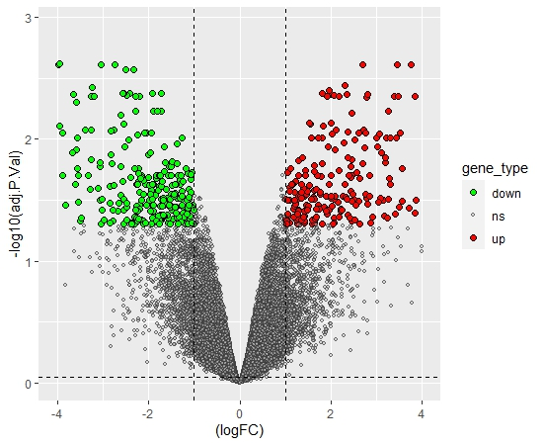
GSE30994 GSE32571 GSE46602
GSE69223 GSE103512 GSE104749

Slide 3
GSE32571 GSE46602
Up (37) Down (100)
Up (498) Down (609)
Up (176) Down (1063)
Up (264) Down (469)
Up (301) Down (559)
GSE30994
GSE69223
Up (169) Down (76)
Up (204) Down (259)
GSE104749 GSE103512

Slide 4
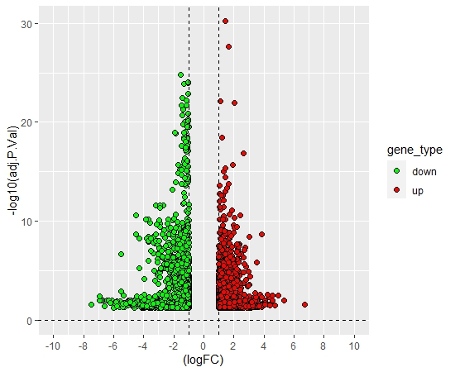

Slide 5
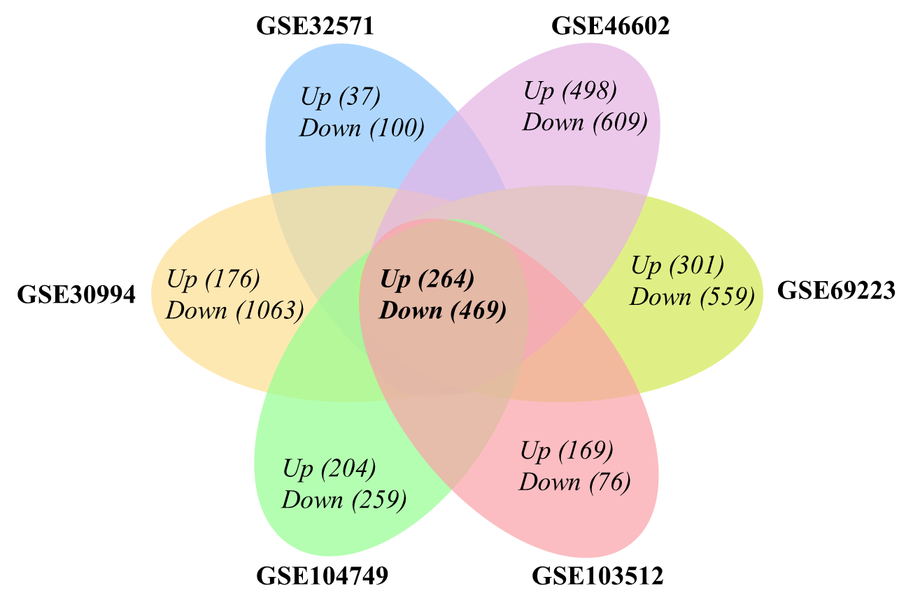

Slide 6
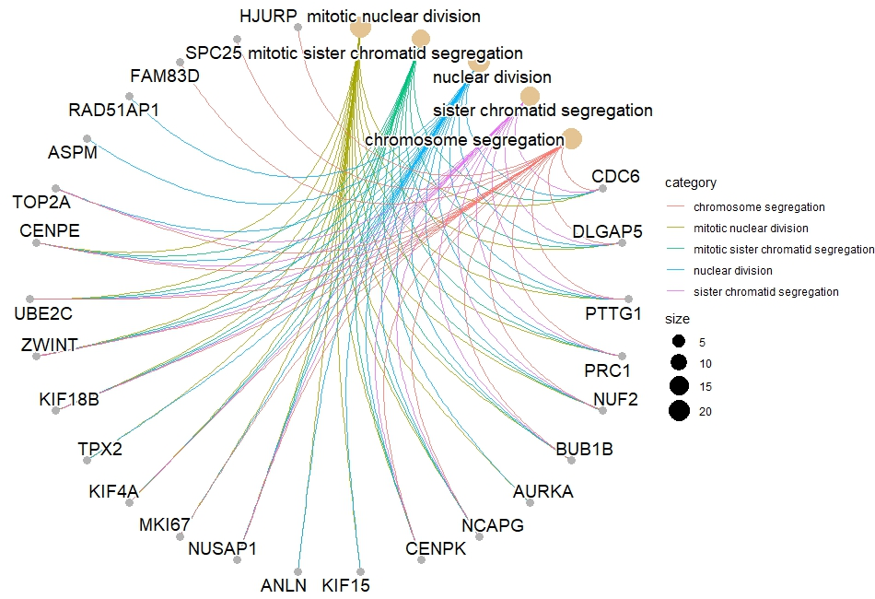
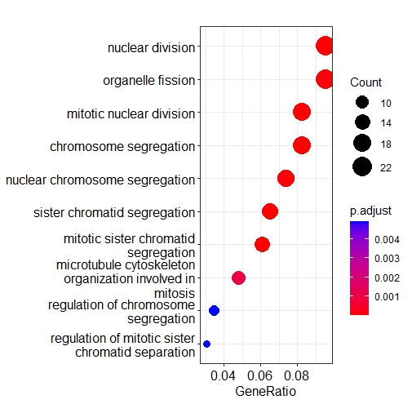
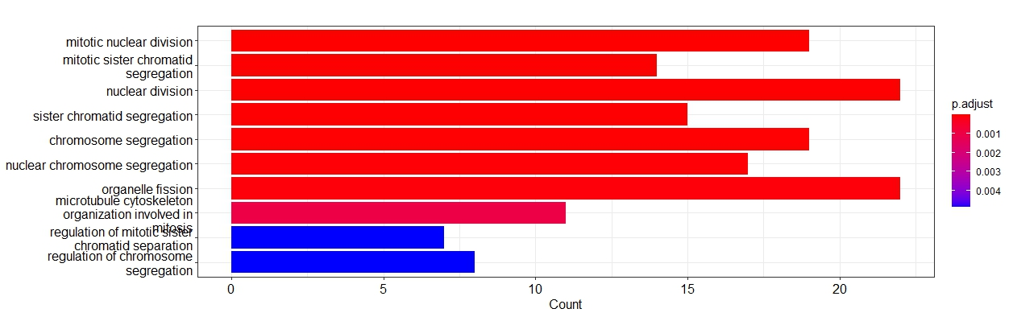
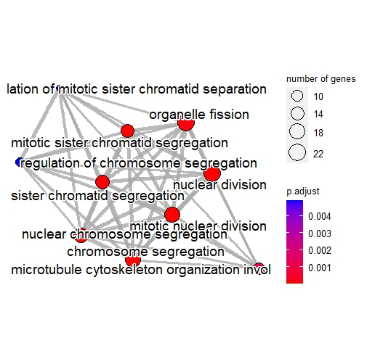
BP

Slide 7
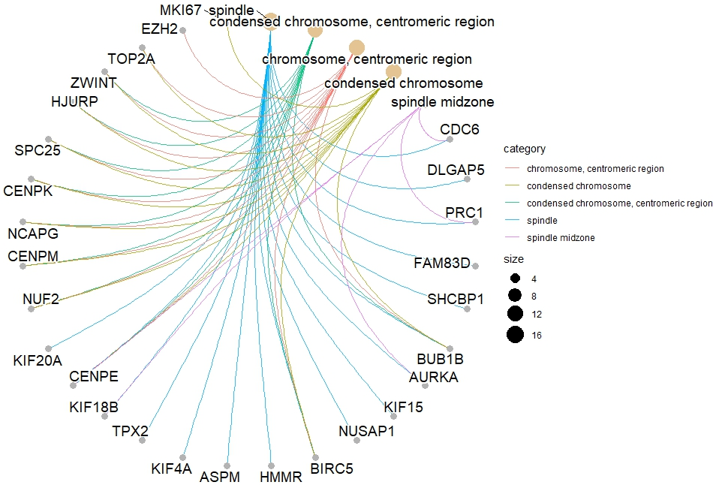
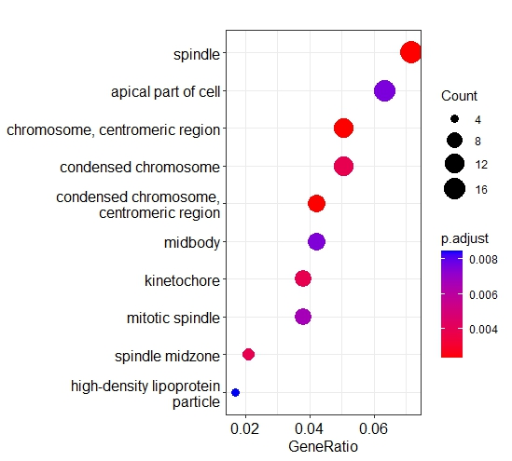
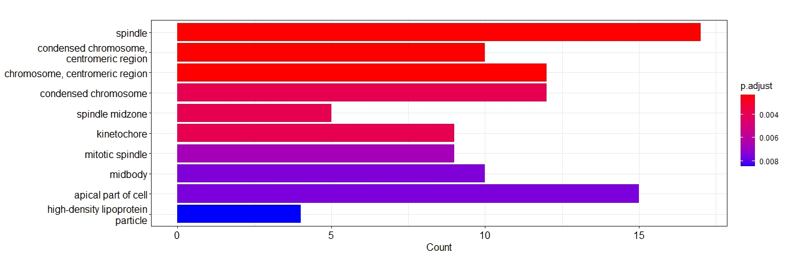
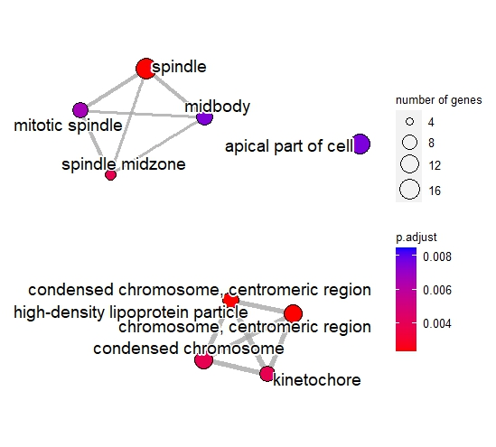
CC

Slide 8
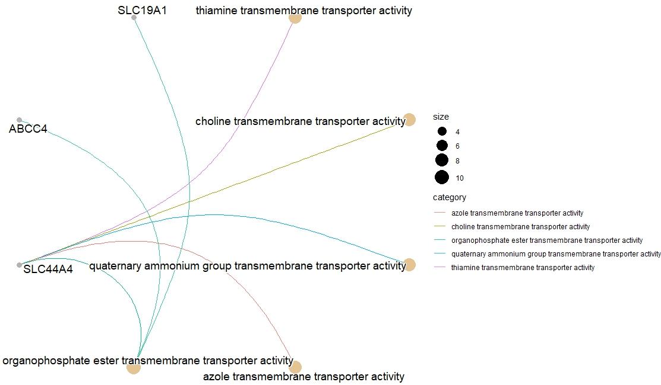
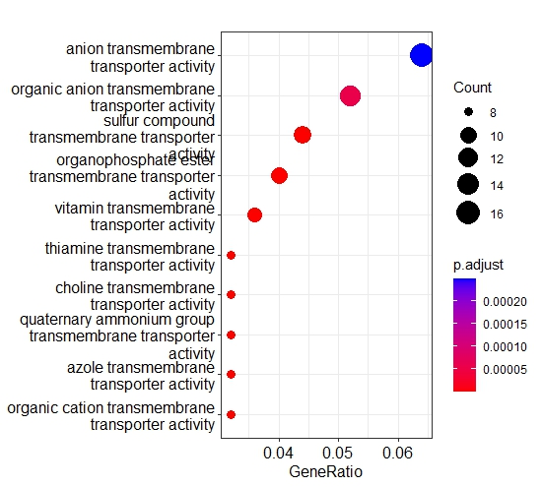
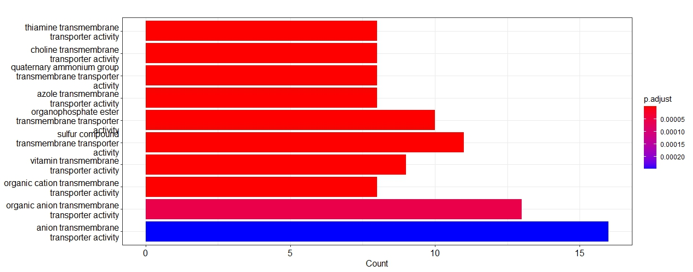
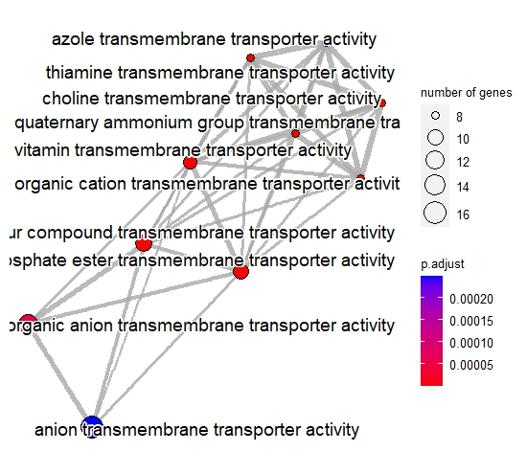
MP

Slide 9
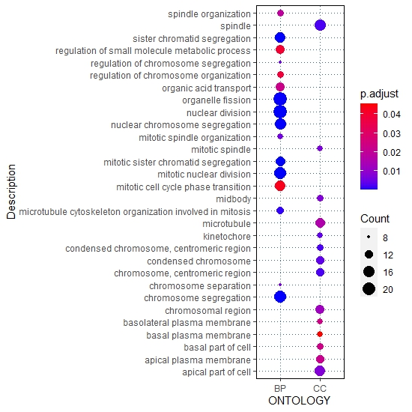
ALL

Slide 10
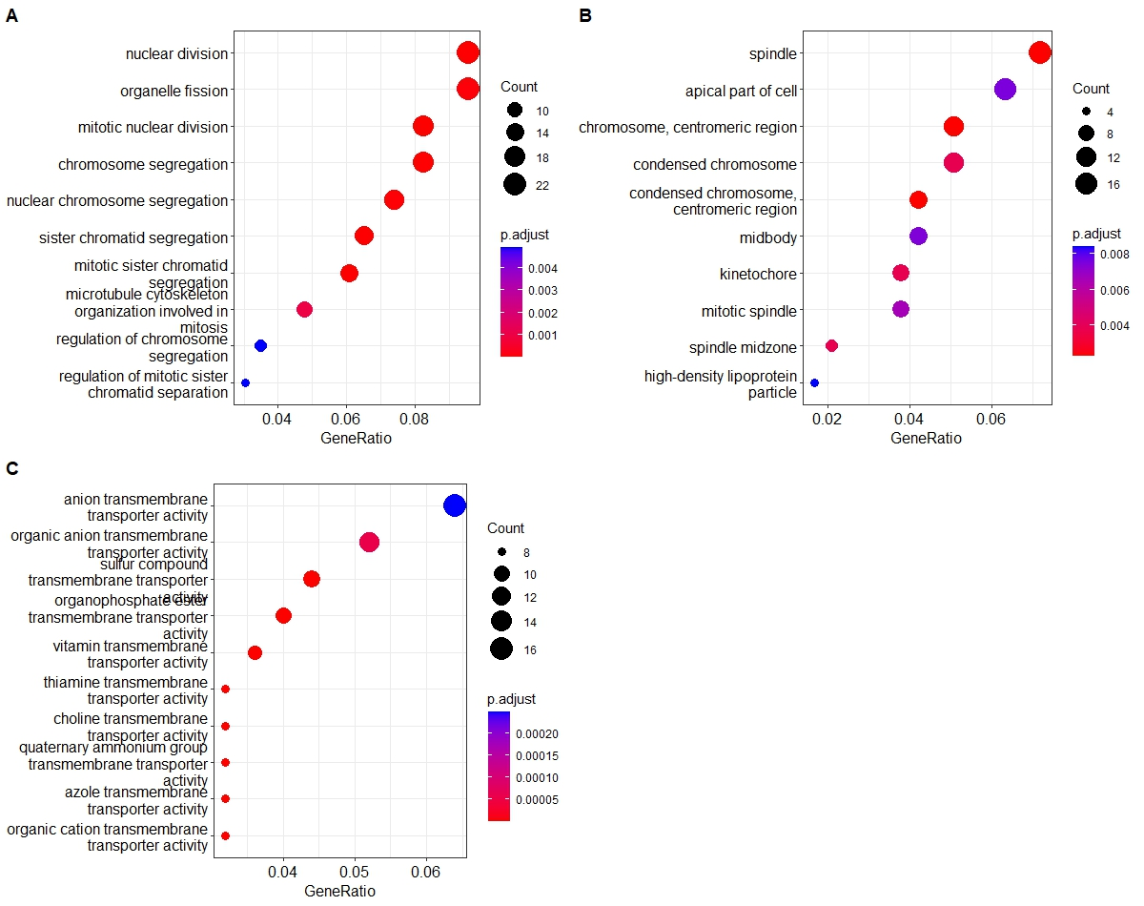
ALL

Slide 11
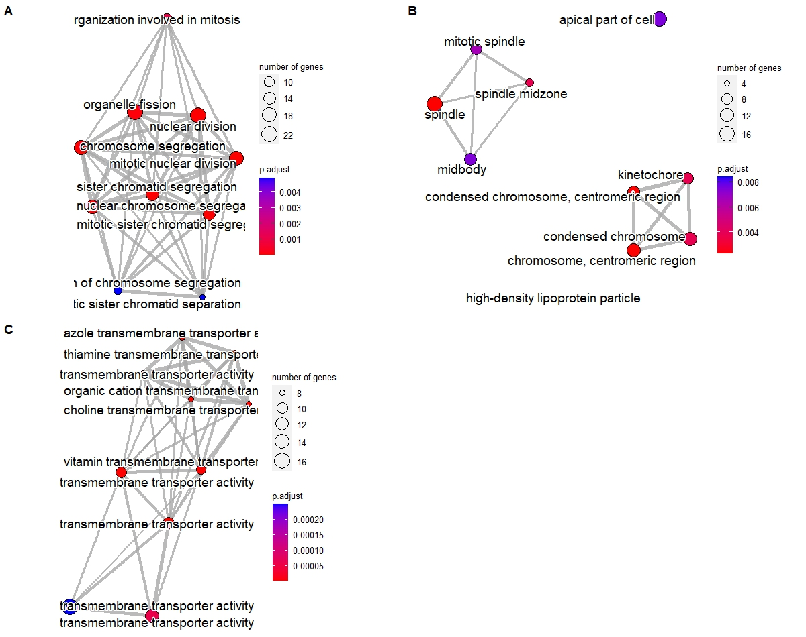
ALL

Slide 12
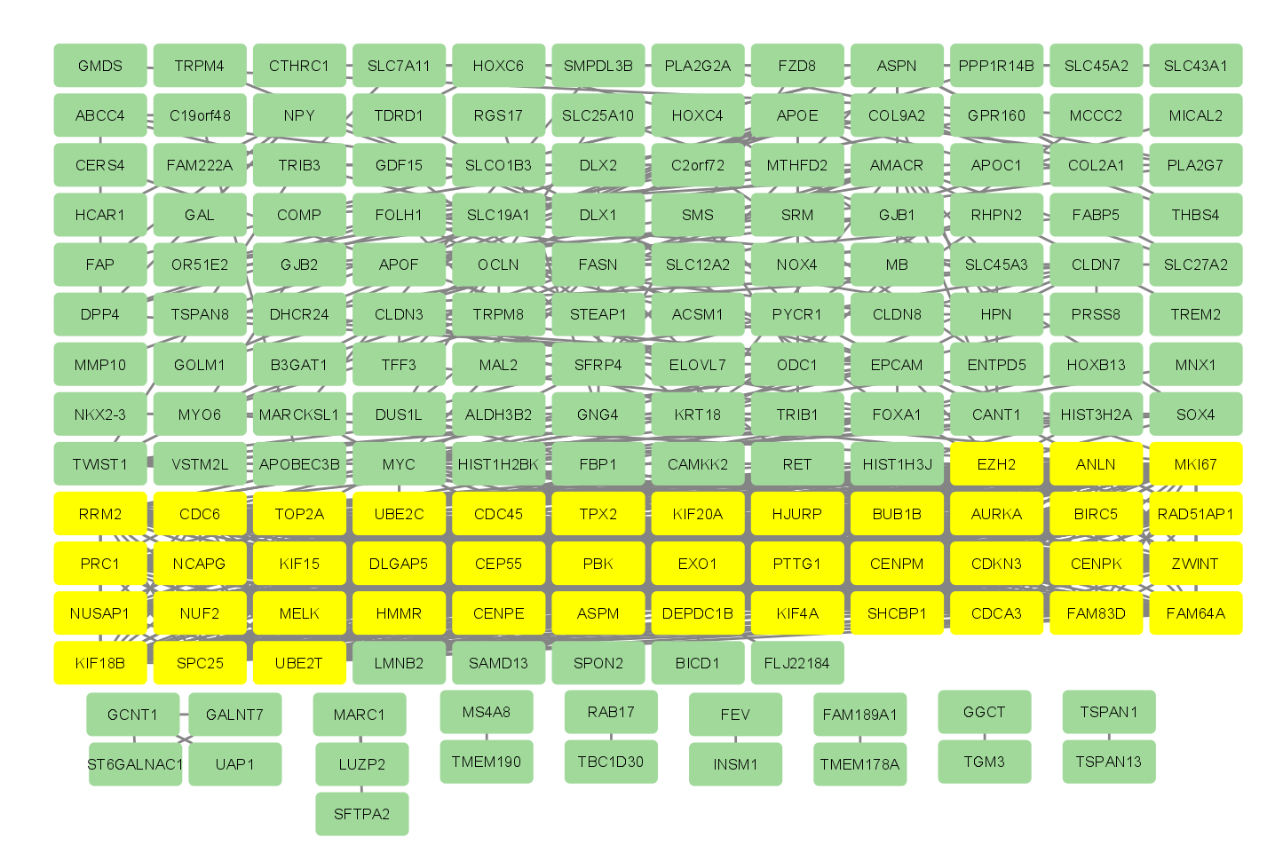

Slide 13
Table 2: 86 Upregulated genes were identified by 12 differential analysis methods, and 27 genes were detached by at least 4 methods
Genes | Freq | Genes | Freq | Genes | Freq | Genes | Freq | Genes | Freq | Genes | Freq
RRM2 | 8 | KRT18 | 5 | FAM64A | 3 | KIF18B | 2 | ASPM | 1 | PRC1 | 1
ANLN | 7 | PBK | 5 | KIF15 | 3 | MELK | 2 | B3GAT1 | 1 | PRSS8 | 1
MKI67 | 7 | TOP2A | 5 | OCLN | 3 | NUF2 | 2 | CANT1 | 1 | SFRP4 | 1
MYC | 7 | TWIST1 | 5 | ODC1 | 3 | NUSAP1 | 2 | CENPK | 1 | SHCBP1 | 1
RAD51AP1 | 7 | UBE2C | 5 | SPC25 | 3 | PTTG1 | 2 | COL2A1 | 1 | SLC27A2 | 1
AURKA | 6 | APOE | 4 | TPX2 | 3 | PYCR1 | 2 | COMP | 1 | SLC45A3 | 1
BIRC5 | 6 | CENPE | 4 | TRIB1 | 3 | UBE2T | 2 | DHCR24 | 1 | SMS | 1
CDC45 | 6 | DLGAP5 | 4 | ZWINT | 3 | APOF | 1 | DUS1L | 1 | SRM | 1
CDC6 | 6 | FASN | 4 | CDCA3 | 2 | CLDN8 | 1 | ENTPD5 | 1 | T6GALNAC1 | 1
EXO1 | 6 | FOLH1 | 4 | DEPDC1B | 2 | MAL2 | 1 | FABP5 | 1 | TRIB3 | 1
EZH2 | 6 | FOXA1 | 4 | DLX1 | 2 | MYO6 | 1 | GALNT7 | 1 | VSTM2L | 1
BUB1B | 5 | NCAPG | 4 | FAM83D | 2 | PLA2G7 | 1 | GOLM1 | 1
CEP55 | 5 | AMACR | 3 | HJURP | 2 | SAMD13 | 1 | HIST3H2A | 1
EPCAM | 5 | CDKN3 | 3 | HMMR | 2 | SOX4 | 1 | KIF4A | 1
KIF20A | 5 | DPP4 | 3 | HPN | 2 | THBS4 | 1 | OR51E2 | 1

